Slide 1
VIVO fuel purchase
Fuel Ownership Changes

Slide 2
Overview
KNK ERP
KOKO Core
KOA APP
KP APP
erp/fuel/inventory(Fuel Inventory record creation)
/v2/koa/refill/task/complete,
/koa/refill/task/complete (MT Task)
update total fuel value in fuel inventory
v2/kp/fuel-points/fuel-purchased
v3/kp/fuel-purchased
update used volume in fuel inventory
erp scheduler call KC API
/api/v1/fuel-inventory-update
aggregated value of fuel based on transaction type

Slide 3

KVM Changes
From this Project we are making changes in ownership which result VIVO won’t require data for Fuel sales so will be removing API and views all related things to fuel sales.
remove interface for fuel sales
remove v1/fuel_sales endpoint.
remove fuel_sale_order class
remove scheduler for fuel_sales API
KVM System Document

Slide 4
KC Changes
Database changes:
Fuel Price
fuel_retail_price
Fuel Inventory Table(fuel_inventory):
start_date (Date)
fuel_price_id
Add functionality:

Slide 5
KC Changes
Fuel Dispense :
remove used_volume_ml functionality from fuel_purhcase.
Add Migration File:
While doing release we need to update ‘total_volume_ml’ in fuel inventory record for active record to support the new changes.
create a migration file which sum up the refill records and update value in our current active record in fuel inventory table.
Remove API:
Now VIVO won’t require data related to fuel sales so will be removing endpoint created for KVM project.
remove kvm/fuel-sales endpoint.

Slide 6
KC Changes
Fuel Inventory:
fuel Inventory record comes from ERP when it goes to confirm status we are making changes in payload which required KC to create record.
Endpoint | Old Payload | New Payload
/erp/fuel/inventory | payload : { fuel_retail_price : float, fuel_wholesale_price: float, erp_inventory_id: int, total_inventory_ml : int } | payload : { date : Date, fuel_retail_price: float, fuel_wholesale_price: float, erp_inventory_id: int }

Slide 7
KC Changes
endpoints | erp/fuel-inventory/update
payload | { fuel_point: { fuel_sale_in_ml : int, free_fuel_sale_in_ml: int, total_kp_adjustement_in_ml: int, total_kp_refill_in_ml: int, total_kp_maintenance_in_ml: int, }, micro_tanker: { total_mt_refill_in_ml: int, total_mt_refill_to_kp_ml: int, total_mt_adjustement_in_ml: int, total_mt_maintenance_in_ml: int }, inventory_valuation: float, job_id : int, task_datetime - timestamp }

Slide 8
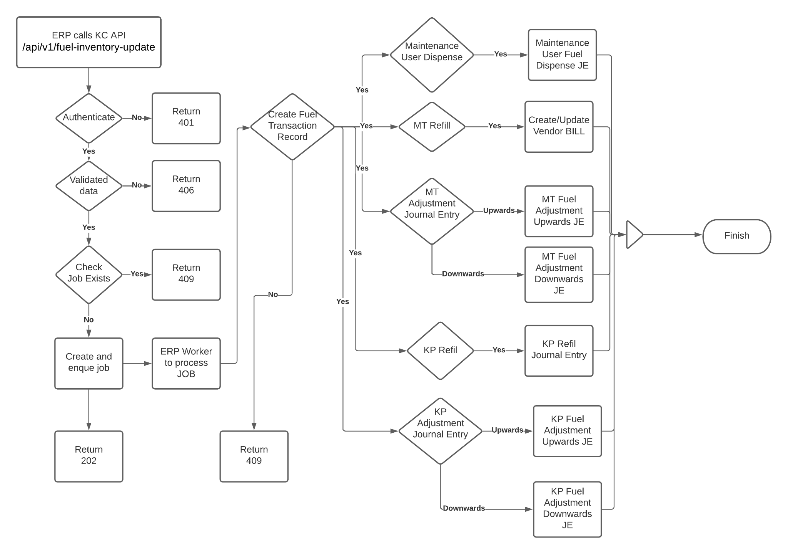
ERP Workflow Diagram

Slide 9
ERP Change
API
Add
New endpoint to receive Fuel Transaction data in ERP from KOKO CORE
New category(koko_update_fuel_transaction) in internal job tracker to process Fuel Transaction data
Table
Add
New table(koko_fuel_transaction) to maintain Fuel Transaction data(1 Record for daily basis)
Function
Update
cron_generate_wholesaler_fuel_invoices(Koko Buys Fuel Cron)
Use MT refill to compute total qty for the day and update vendor(1 Bill with qty from micro tanker refill)

Slide 10
ERP Changes
Configuration
Update
Update Maintenance User Fuel Setting and remove Stock and Cogs JE config to stop creating COGS Journal Entry
Update Maintenance User Fuel Setting and update Payment JE accounts as per ENTRY 6 on Maintenance User Journey SHEET
Update Koko Fuel Purchase Config and remove value from TPUF(Technical Platform User Fee) config to disable TPUF invoice creation
Update Ethanol Product and remove Taxes and update Expense Account as per ENTRY 1 on Maintenance User Journey SHEET
Add
Add new configuration for Fuel Adjustment Journal Entry
Add new configuration for KP refill Journal Entry

Slide 11
ERP Journal Entry Creation (once a day)
Journal Entry | Journal Entry Reference (Excel) | Excel Sheet Name | Type
When KOKO Buy Fuel(Supplier Invoice for VIVO) | 1 | Maintenance User Journey | Update (Add new ledger to configuration)
Micro Tanker Fuel Adjustments (Upwards) | 2a | Maintenance User Journey | New
Micro Tanker Fuel Adjustments (Downwards) | 2b | Maintenance User Journey | New
KP Fuel Refill | 3 | Maintenance User Journey | New
KP Fuel Adjustments(Upwards) | 4a | Maintenance User Journey | New
KP Fuel Adjustments(Downwards) | 4b | Maintenance User Journey | New
Maintenance user dispenses | 6 | Maintenance User Journey | Update(Add new ledger to configuration)

Slide 12
New ERP Tables
Table Name | Structure | Description
koko_fuel_transaction | Date - datetime job - Many2one(internal.job.tracker) total_fuel_sale_in_ml - int total_free_fuel_sale_in_ml - int total_kp_adjustement_in_ml - int total_kp_refill_in_ml_in_ml - int total_kp_maintenance_user_dispense - int total_mt_refill_in_ml - int total_mt_refill_to_kp_ml - int total_mt_adjustment - int total_mt_maintenance_user_dispense - int inventory_valuation - float wholesaler_id - Many2one(res.partner) index on wholesaler_id index on date | Table will store Fuel Adjustments, Fuel Sales, MT Refill and Valuation of current inventory for daily basis

Slide 13
New ERP Tables
Table Name | Structure | Description
koko_fuel_adjustments | mt_adjustments_ids - one2many(koko.mt.adjustment.je) kp_adjustments_ids - one2many(koko.kp.adjustment.je) | Configuration to store Fuel Adjustment Journal Entries and ledger for KP and MT
koko_mt_adjustment_je | journal_id - Many2one(account.journal) koko_mt_adjustment_ji_ids - one2many(koko.mt.adjustment.ji) | Relational Table linked with koko_fuel_adjustment to store Journal entry configuration for MT adjustments
koko_kp_adjustment_je | journal_id - Many2one(account.journal) koko_kp_adjustment_ji_ids - one2many(koko.kp.adjustment.ji) | Relational Table linked with koko_fuel_adjustment to store Journal entry configuration for KP adjustments
koko_mt_adjustment_ji | account_id - Many2one(account.account) type - selection (debit/credit) calculation - char | Relational Table linked with koko_mt_adjustment_je to store Ledger and calculation details of MT adjustments
koko_kp_adjustment_ji | account_id - Many2one(account.account) type - selection (debit/credit) calculation - char | Relational Table linked with koko_kp_adjustment_je to store Ledger and calculation details of KP adjustments

Slide 14
New ERP Tables
Table Name | Structure | Description
koko_kp_refill | kp_refill_ids - one2many(koko.kp.refill.je) | Configuration to store KP Refill Journal Entries and ledger
koko_kp_refill_je | journal_id - Many2one(account.journal) koko_kp_refill_ji_ids - one2many(koko.kp.refill.ji) | Relational Table linked with koko_kp_refill to store Journal entry configuration for KP Refill
koko_kp_refill_ji | account_id - Many2one(account.account) type - selection (debit/credit) calculation - char | Relational Table linked with koko_kp_refill_je to store Ledger and calculation details of KP Refill

Slide 15
ERP Queue(RABBIT MQ) Changes
Queue name | Queue Function | Description | Why ?
fuel_transaction | create_fuel_transaction | Responsible for creating fuel transaction and Journal Entry | To make sure we have payload stored so that we can re queue in worst case scenario.
Add
New queue
Add New Queue called as fuel_transaction
New Function
Add New queue function called as create_fuel_transaction to handle aggregate data and create/update respective Journal Entry
Update
Function
Update enque_job function and add new queue(fuel_transaction) and function(create_fuel_transaction) details
Decorator
Add function(create_fuel_transaction) and queue name in the Celery decorator file

Slide 16
New Route To Get Fuel Transaction details
New Route | Expected Data in Response
erp/fuel-inventory/update | { fuel_point: { fuel_sale_in_ml : int, free_fuel_sale_in_ml: int, total_kp_adjustement_in_ml: int, total_kp_refill_in_ml: int, total_kp_maintenance_in_ml: int, }, micro_tanker: { total_mt_refill_in_ml: int, total_mt_refill_to_kp_in_ml : int, total_mt_adjustement_in_ml: int, total_mt_maintenance_in_ml: int }, inventory_valuation: float, job_id : int, task_datetime - timestamp }

